Slide 1
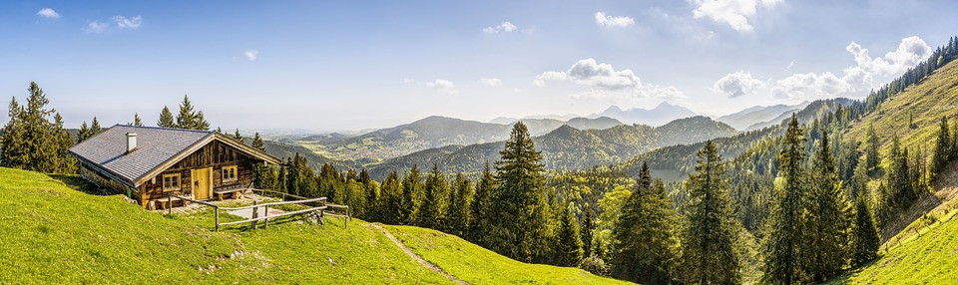
1.The Multidisciplinary Nature of Environmental Studies
LECTURE By :G.SRINIVAS

Slide 2


Slide 3
The Multidisciplinary Nature of Environmental Studies
You will learn
DEFINITION, SCOPE & IMPORTANCE OF ES
Environmental Values : Direct, Indirect & Option values
Environmental Services : Global, Regional & Local
2. NEED FOR PUBLIC AWARENESS
People in the Environment
Salim Ali, Indira Gandhi, M.S.Swaminathan, Madhav Gadgil, M.C.Mehata, Anil Agarwal, Medha Patkar, & Sunder Lal bahuguna
Institutions in the Environment:
BNHS, BSI, ZSI, CPCB, CSE, BVIEER, CPR-EEC, CEE, MCBT, SACON, WWF-I, WII, MoEF.

Slide 4
1.1 Introduction, Scope & Importance of ES
“If you plan for one year, plant rice, if you plan for 10 years plant trees and if you plan for 100 years, educate people”
So, if we want to manage our earth, we must make people environmentally educated.
Definition:
Environment can be defined as the circumstances or conditions that surrounds an organism.
Environmental Studies is the scientific study of the environmental system and the status of its changes on organism
Or
Environmental Sciences, is the systematic study of our environment and existence in it

Slide 5
ES..
Environmental studies deals with every issue that affects an organism. It is essentially a multidisciplinary approach that brings about an appreciation of our natural world and human impacts on its integrity.
It is an applied science as its seeks practical answers to making human civilization sustainable on the earth’s finite resources.

Slide 6
1.1 MULTIDESCIPLINARY NATURE OF ES
Environment is not a single subject.
It is an integration of several subjects that include both Science and Social Studies.
To understand all the different aspects of our environment we need to understand biology, chemistry, physics, geography, resource management, engineering, sociology, health, anthropology, economics, statistics, computers (IT), philosophy and population issues.
Thus the scope of environmental studies is extremely wide and covers some aspects of nearly every major discipline.

Slide 7
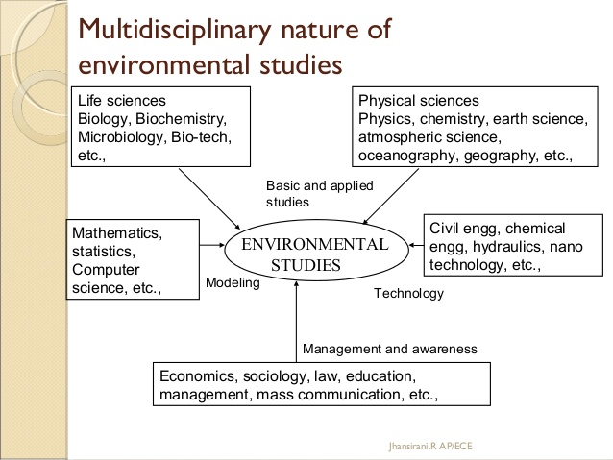

Slide 8
Principles of environmental education:
Examine the major environmental issues
Discover the root cause
Develop problem solving skills
Promote co-operation in solving problems
Emphasis active participation in prevention and solution to problems.

Slide 9
Framework for addressing environmental problem
Scientific Assessment:
Collection of information, data, simulations , model, predict the future
Risk Analysis:
Results from simulations are analyzed. Potential effects
Public Education and involvement:
Through publications, awareness through media
Explanation of the problem along with probable cost
Political Action:
Course of Action
Evaluation:
Actions to be evaluated, monitored
Improve the initial assessment
Scientific Assessment
Risk Analysis
Public Education and Involvement
Political Action
Evaluation

Slide 10
Major Global Environmental Problems
Rapid population growth
Food shortage and famines
Water Shortage
Depletion of non renewable fossil fuel
Damage to the environment
Acid Rains
Global Warming, ozone depletion
Deforestation
Disposal of solid and hazardous wastes

Slide 11
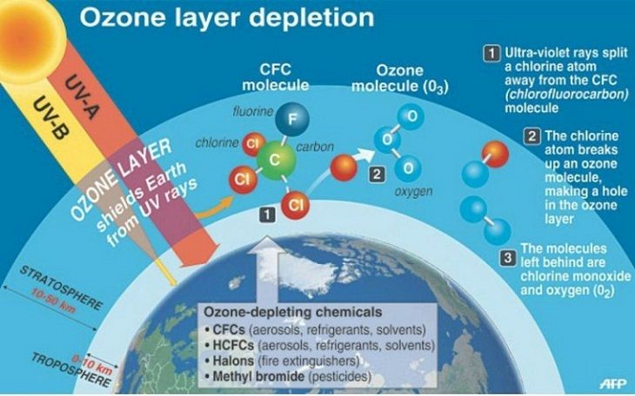

Slide 12
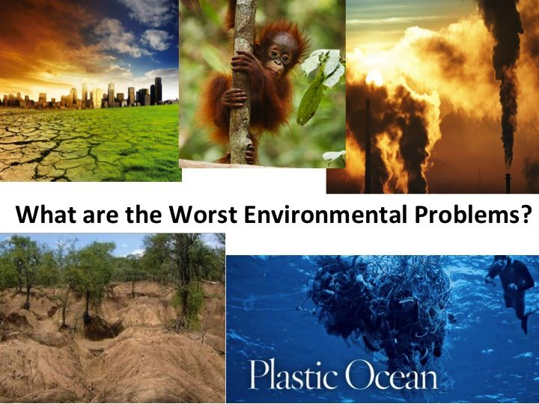

Slide 13
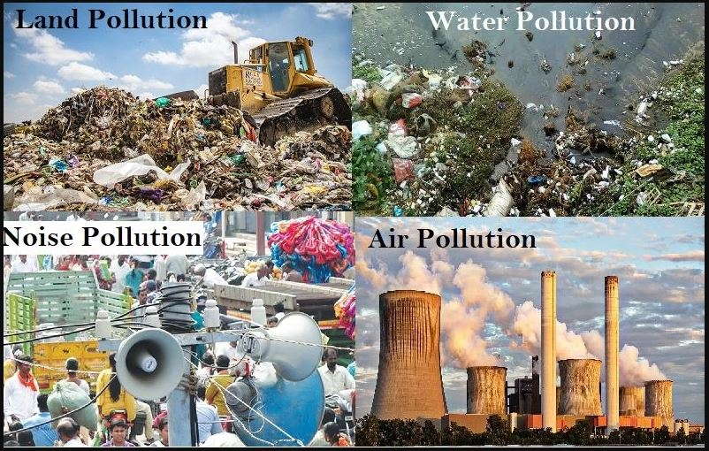

Slide 14
EVIDENCE THAT CLIMATE IS CHANGING
In addition to temperature observations, over recent decades -
Evaporation & rainfall are increasing;
Permafrost is melting;
Corals are bleaching;
Glaciers are retreating;
Sea ice is shrinking;
Sea level is rising;
Wildfires are increasing;
Storm & flood damages are soaring.

Slide 15
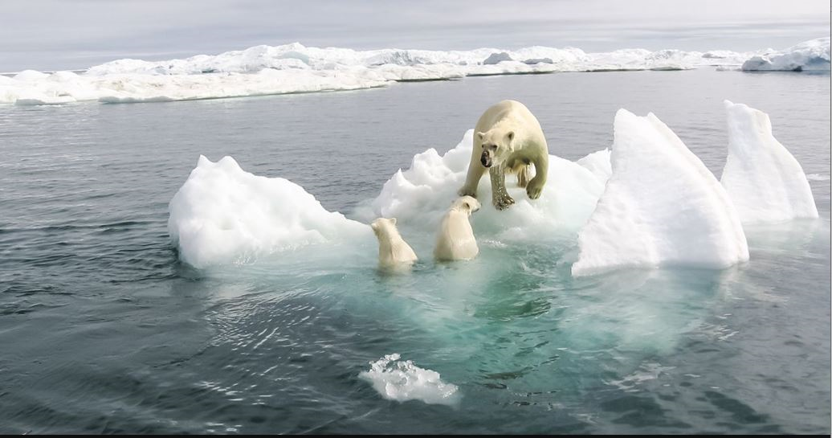
Effect of global Warming

Slide 16
Objectives of environmental studies
Awareness
To help people acquire an awareness of and a sensitivity to the total environment and its allied problems
Knowledge
To help people acquire basic understanding of the total environment and associated problems
Attitude
To help people acquire social values, strong feelings of concern for the environment and the motivation to act in protecting and improving
Skills
To help people acquire the skills for identifying and solving environmental problems
Evaluation Ability
Evaluate environmental measures and education programs
Participation
Active involvement at all levels in working towards resolving environmental problems

Slide 17
Importance of Environmental Studies
Conservation of energy by introduction alternate sources, improved technologies, processes compatible with environment.
Increase in economic productivity through improved health of people.
Conservation of fast depleting natural resources.

Slide 18
Importance of Environmental Studies
New ways and means to maintain ecological balance.
Knowledge about waste management, treatment and disposal techniques.
Social responsibility towards control of environmental pollution and protection

Slide 19
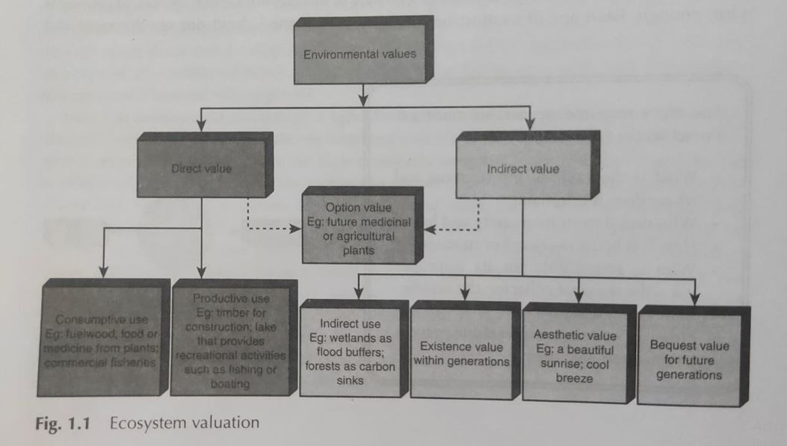
Environmental values

Slide 20
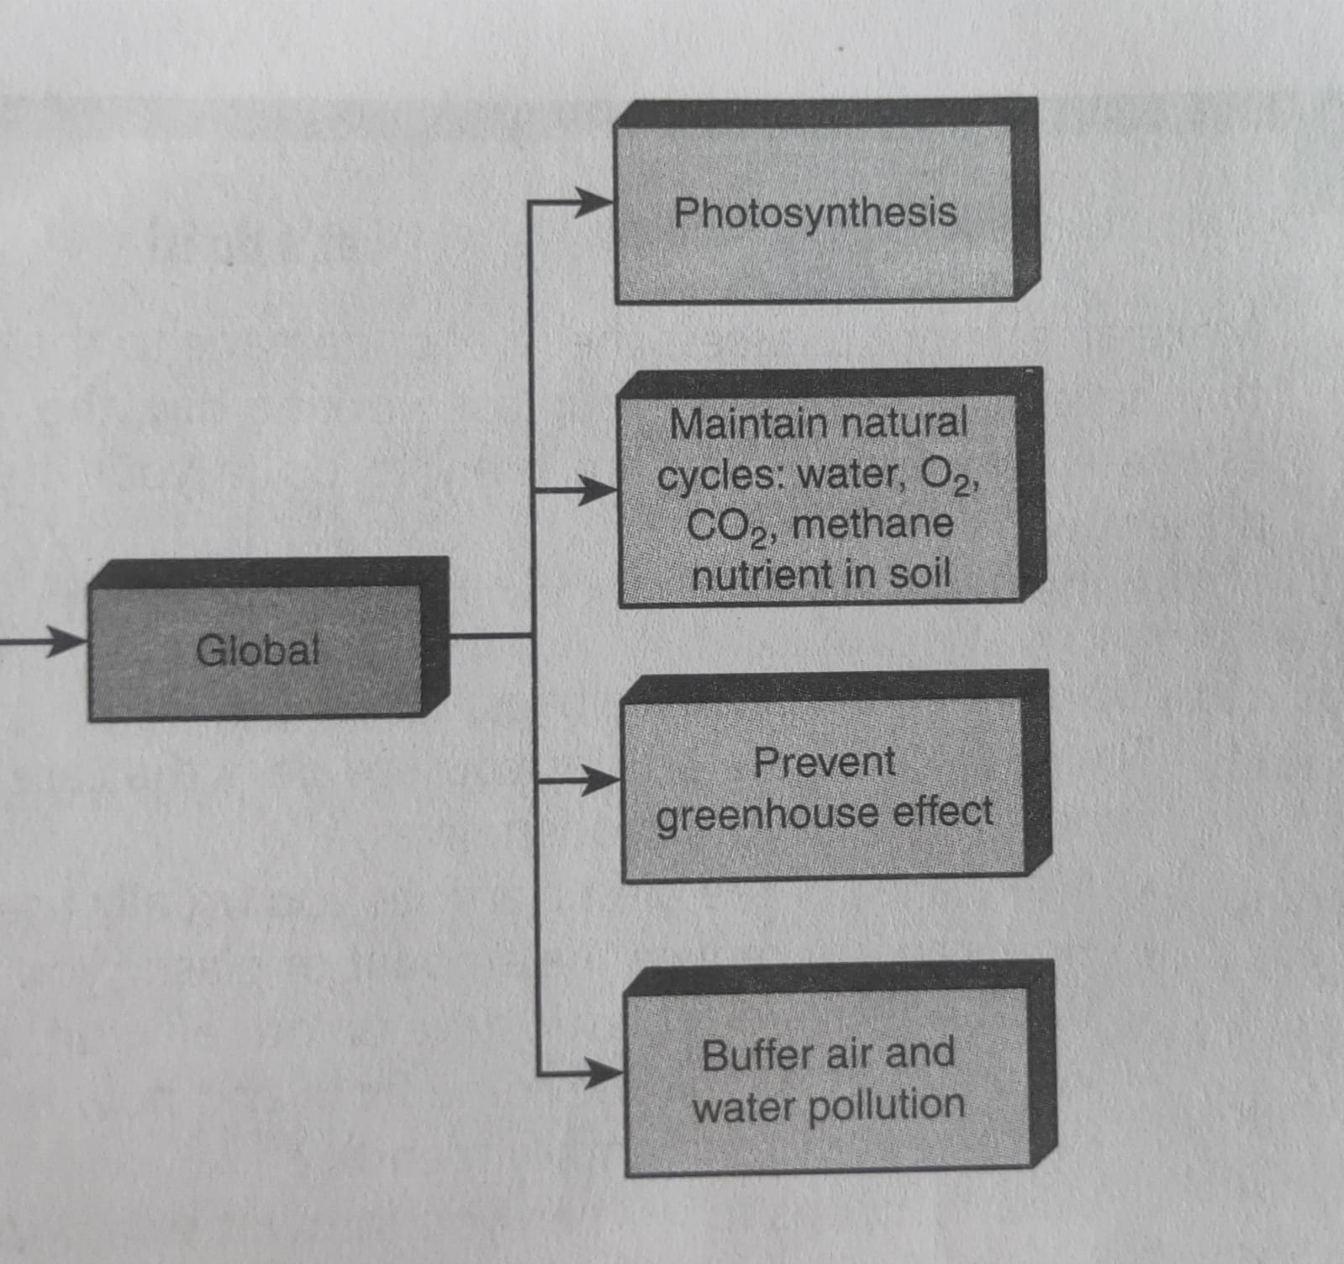
Environmental services : Global, Regional & Local

Slide 21
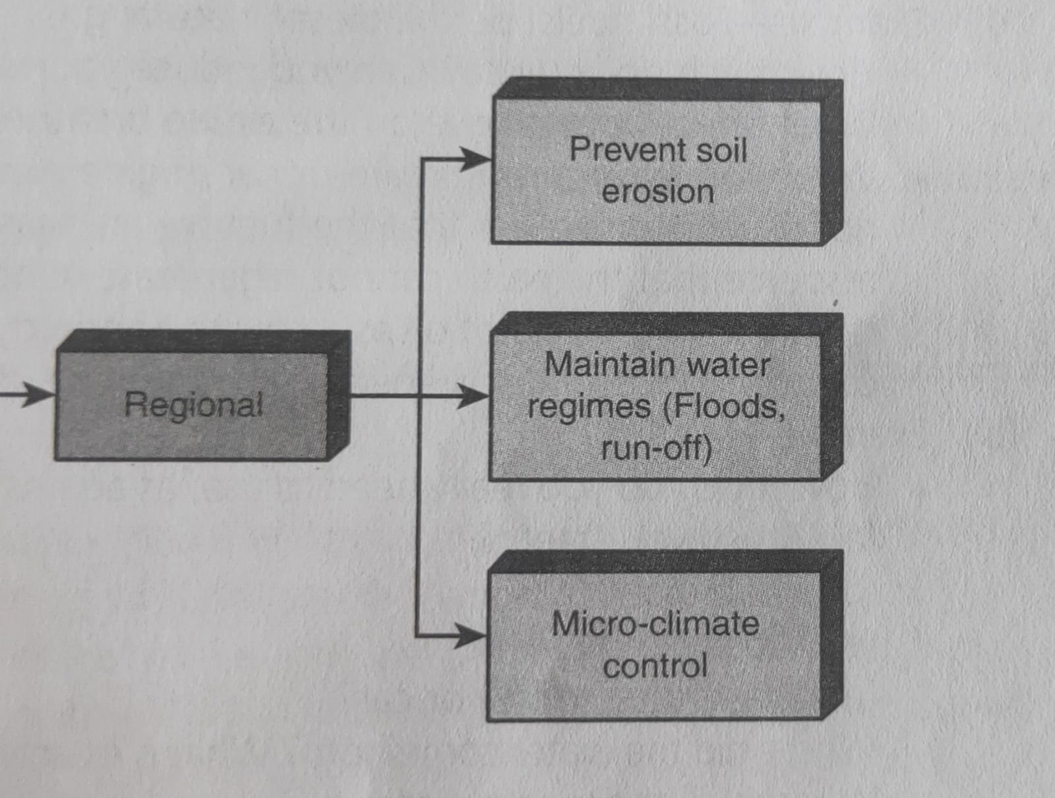
Environmental services : Global, Regional & Local

Slide 22
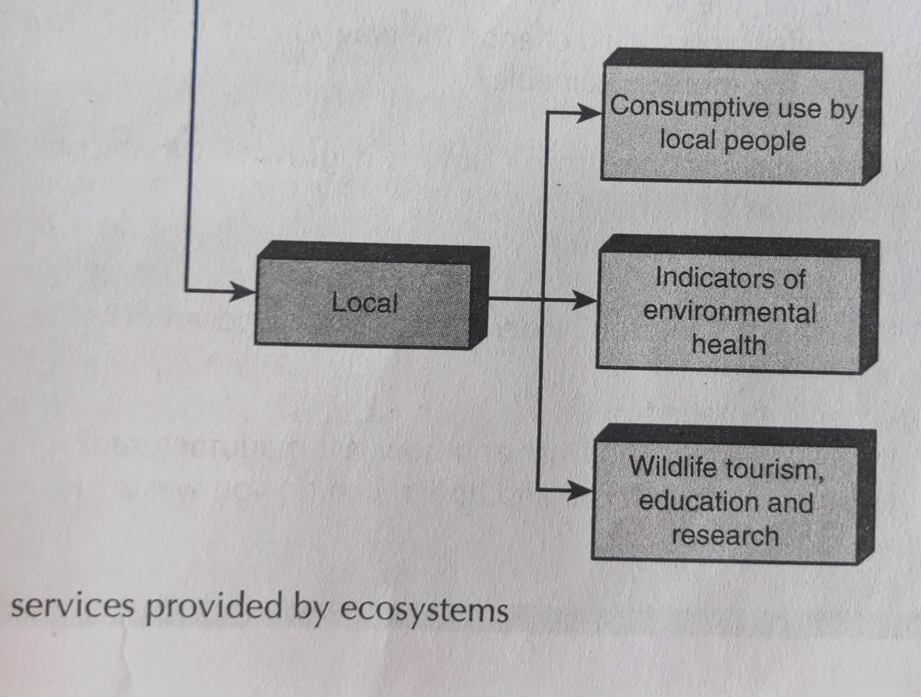
Environmental services : Global, Regional & Local

Slide 23
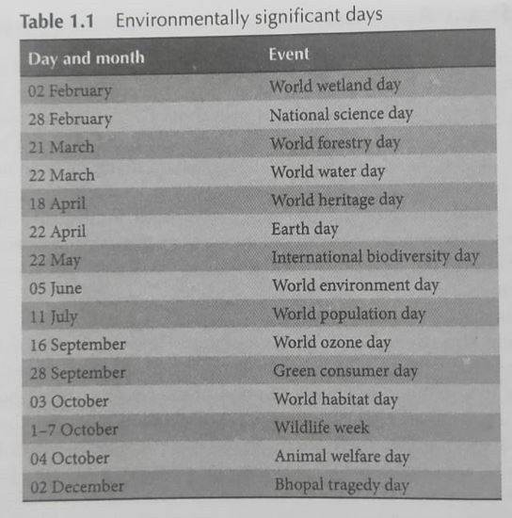
Environmental Significant Days

Slide 24
Activity 1:
LET’S DO
Take any article that you use in daily life –
a bucket full of water, or an item of food, a table, or a book.
Trace its components journey backwards from your home to their origins as natural resources in our environment.
How many of these components are renewable resources and how many non-renewable?

Slide 25
Activity 2:
LET’S DO
Try to answer the questions above for one of the components in the article you chose in Activity1.
Then answer the following questions:
a). Are you using that resource unsustainably?
b). In what ways could you reduce, reuse
and recycle that resource?
c). Is there an unequal distribution of this resource so that you are more fortunate than many others who have less access to it?

Slide 26
Activity 3:
LET’S DO
Think of all the things that you do in a day. List these activities and identify the main resources used during these activities.
a). What can you do to prevent waste, reuse articles that you normally throw away, what recycled materials can you use?
b). Think of the various energy sources you
use everyday. How could you reduce their use?

Slide 27
Next Lecture : L2
1.2 People in the Environment, Institutes in the Environment
__________________________
THANK YOIU

Slide 28
